Slide 1

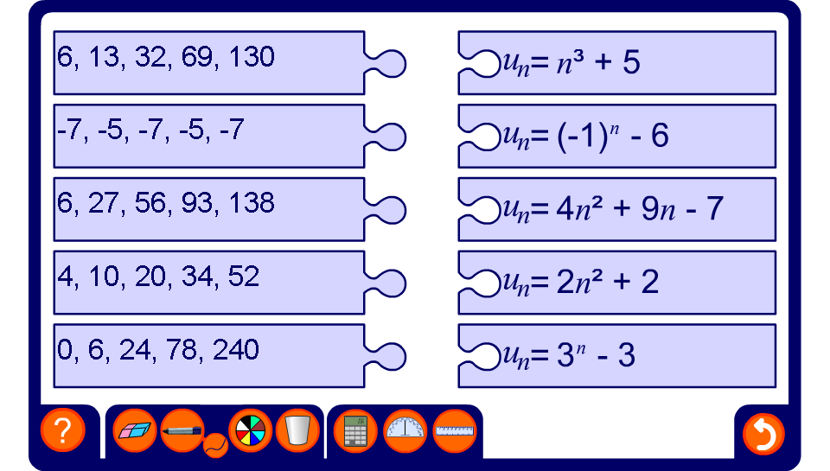


Matching sequences to rules

